Slide 1
Use of Excel for EDA
PivotTables

Slide 2

What are PivotTables
Penguins PivotTables
A powerful tool for summarizing and presenting data.
It does everything we've already learned, only it can be much faster and more efficient.
They are very suitable for exploratory data analysis, as they allow us to aggregate and present data in very different and very fast ways.
Can't be used for everything: some options and charts that can be used with Data Ranges or Tables can't be used with PivotTables.

Slide 3
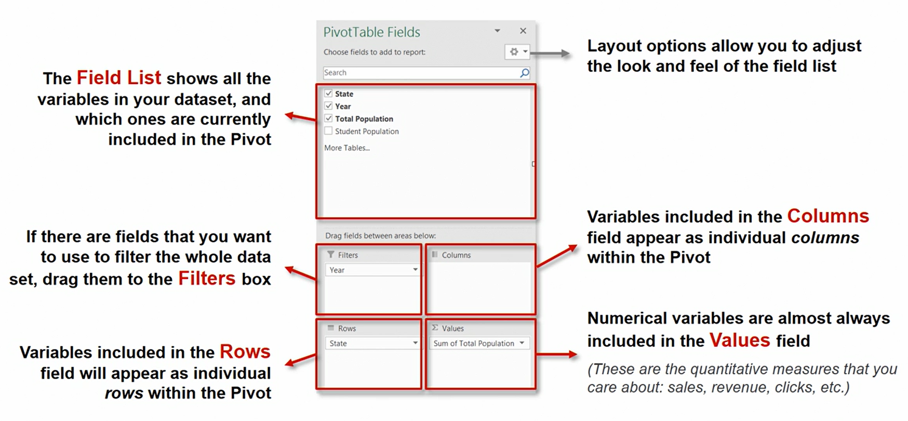
Create a PivotTable to analyze worksheet data
Penguins PivotTables

Slide 4
PivotTables
Exercises PivotTables
We will focus on the following basic features of PivotTables:
Create a PivotTable to analyze worksheet data
Use the Field List to arrange fields in a PivotTable
Filter data in a PivotTable
Create a PivotChart

Slide 5

Tutorials and videos about PivotTables
Overview of PivotTables and PivotCharts
Basic tutorial on PivotTables
and PivotCharts

